Slide 1
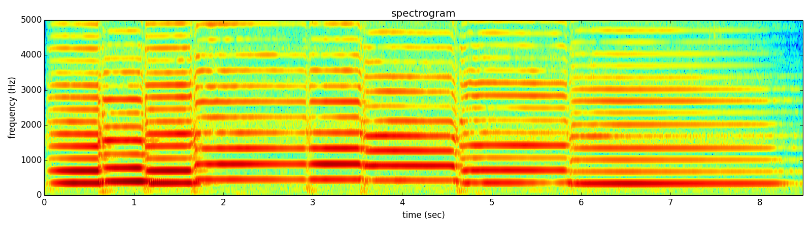
Notes:
Let me show you an example of the more practical things that we will learn to do in the course.
This is the spectrogram of a sound I played in my cello.

Slide 2
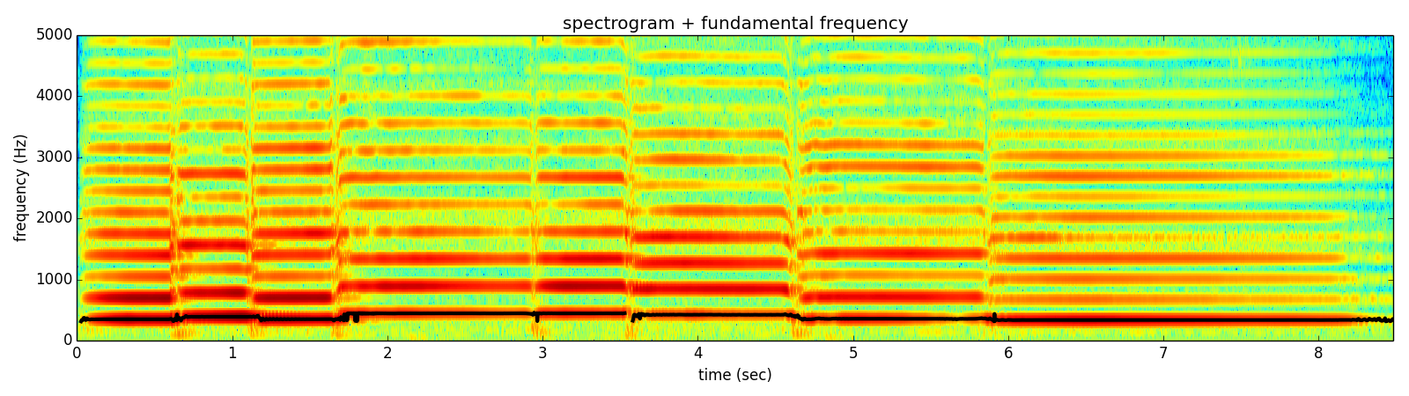
Notes:
From the spectrum we can identify the fundamental frequency of the sound, which can be synthesized as a sinewave.

Slide 3
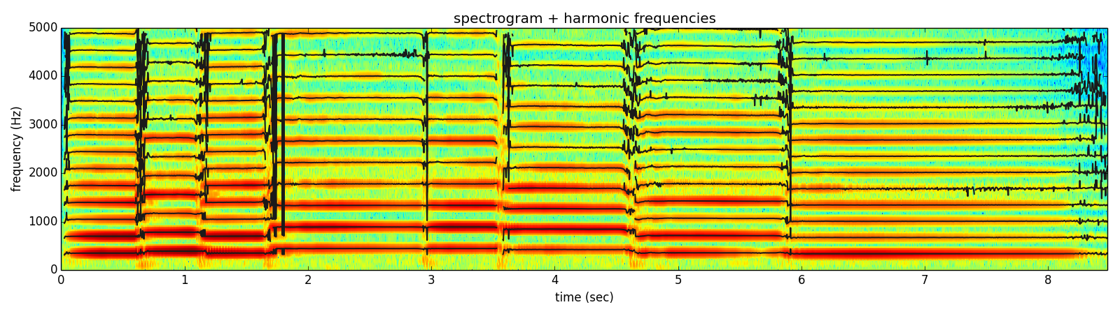
Notes:
We can then detect the harmonics of that fundamental frequency.
But there is more to the sound than just the harmonics.

Slide 4
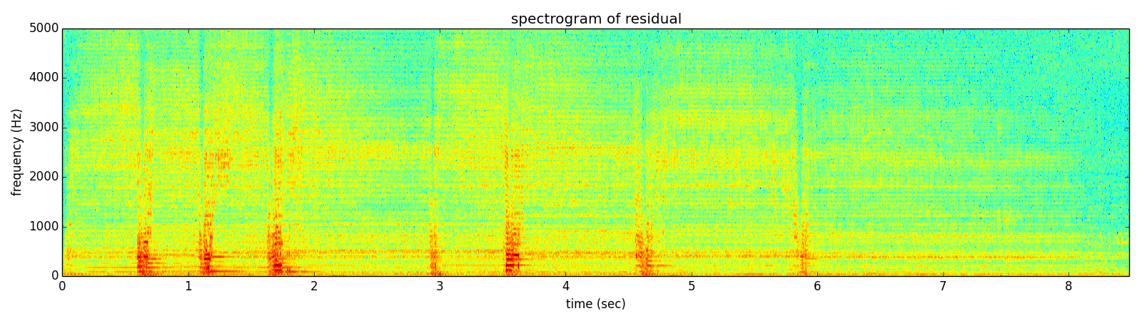
Notes:
If we subtract them from the original sound we can get the spectrum of what is left, and listen to it.

Slide 5
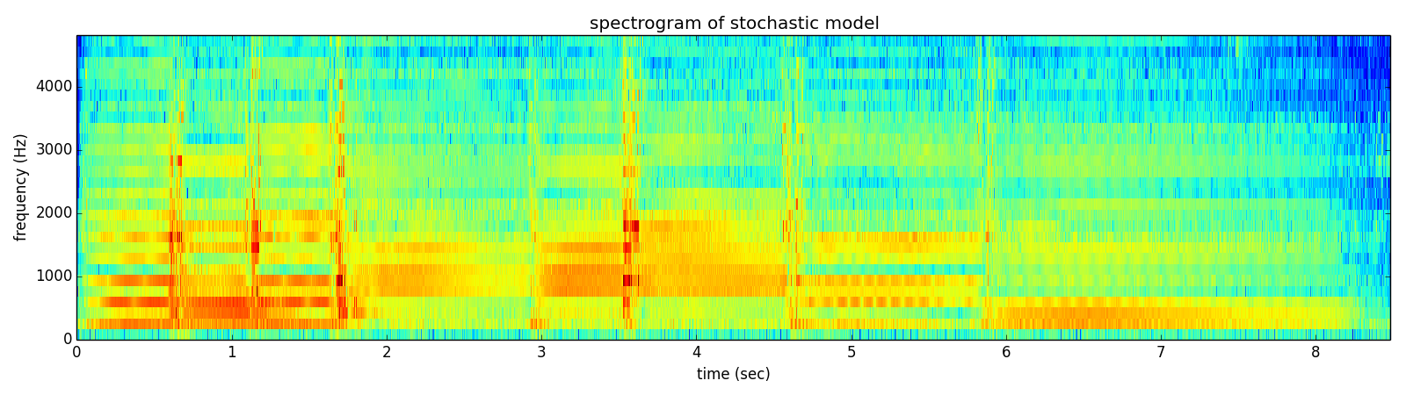
Notes:
This residual spectrogram can be approximated with an stochastic model,

Slide 6
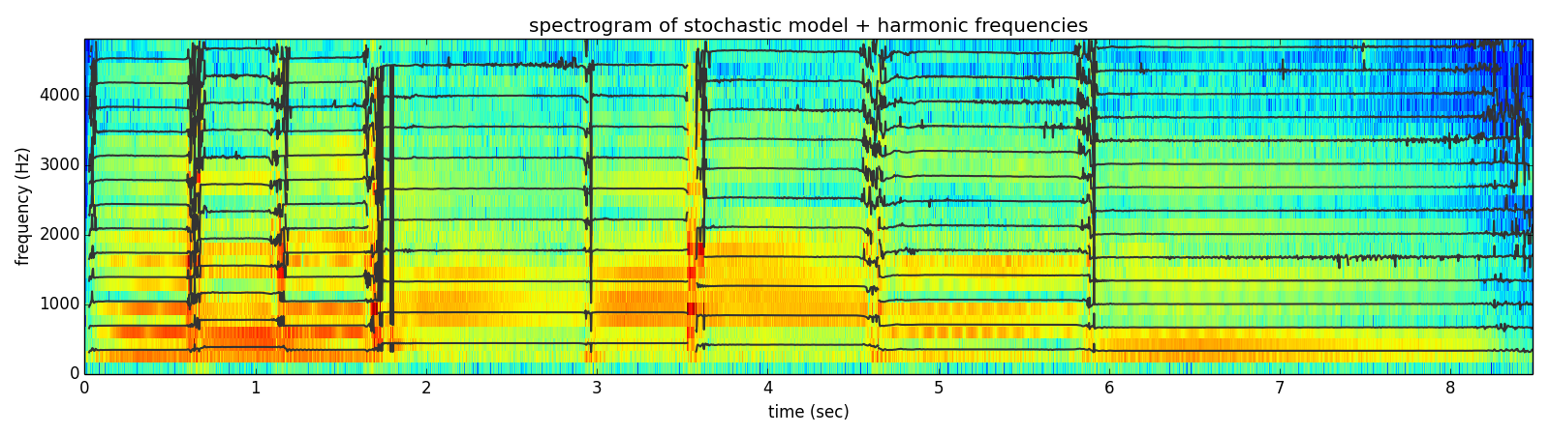
Notes:
and we can put it together with the harmonics to obtain a representation with which we can do many things,

Slide 7
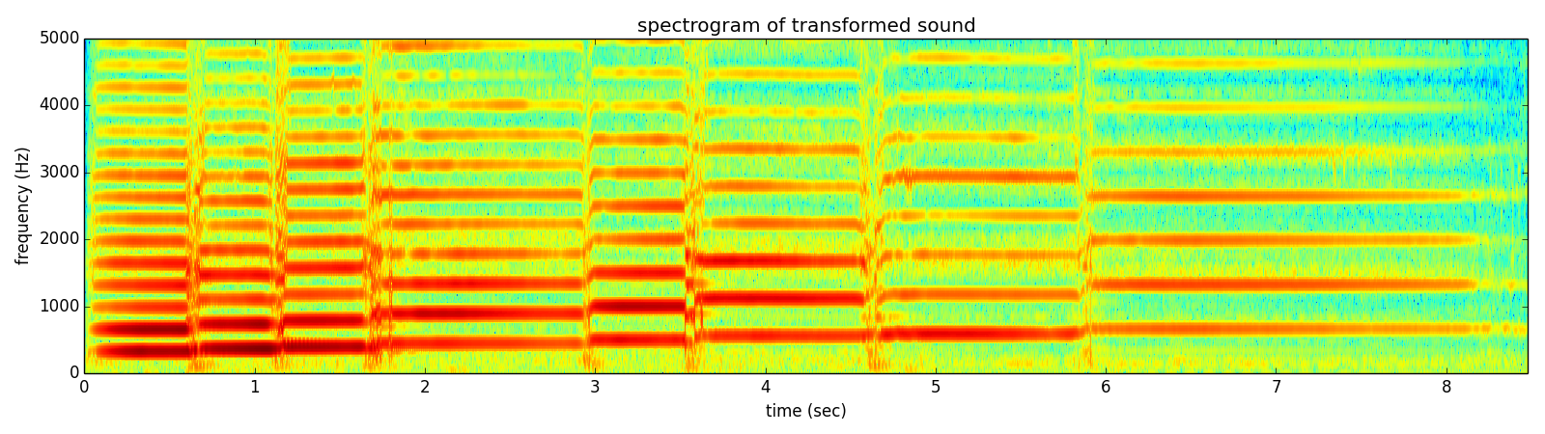
Notes:
like synthesizing the sound again but with the notes changed,

Slide 8
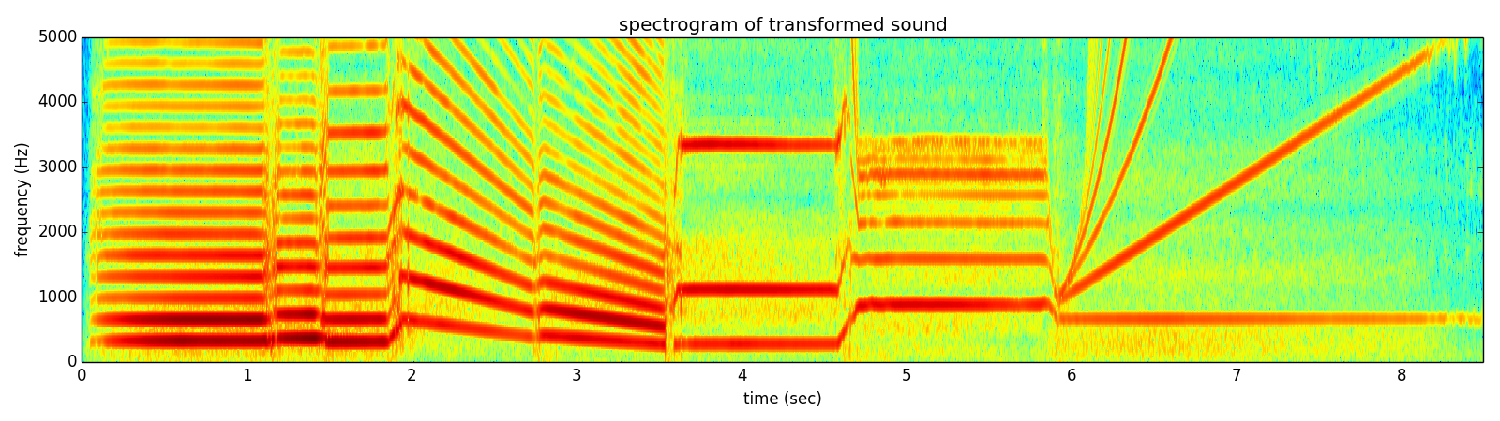
Notes:
or we can generate some weird sound like this one,
The number of possible transformations is infinite; only bounded by your own creativity.

Slide 9
Notes:
The number of possible transformations is infinite; only bounded by your creativity.

